Slide 1
Dual Enrollment Informational Packet

Slide 2
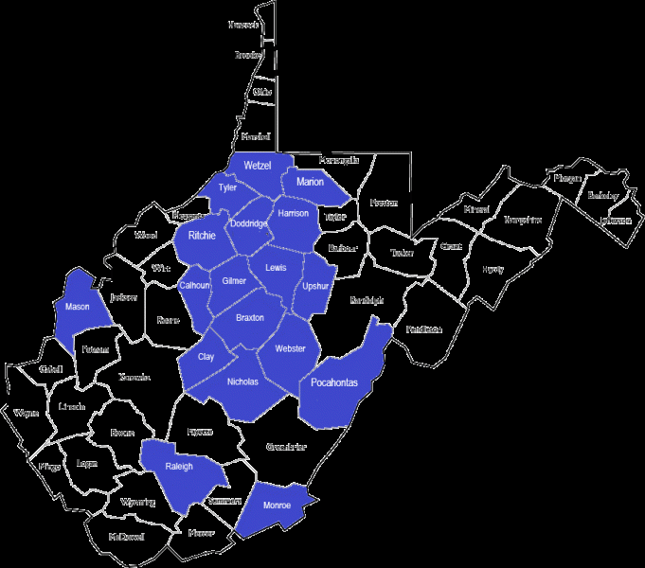
WHAT WILL GLENVILLE STATE COLLEGE DO FOR YOU?
High school students (juniors and seniors) are eligible to enroll in college level courses at Glenville State College through the Pioneer Early Entrance Program (PEEP). This early entrance option allows students to earn both high school and college requirements-hence the name “dual credit.” We currently have enrollment between 200 and 400 students each semester within Eighteen (18) counties.
Students who complete coursework as Dual Enrollment are being proactive and getting a head start on their college careers. They are also advancing with a great cost savings to themselves. GSC is currently offering dual credit courses at the lowest price in the history of the program. Once enrolled in courses students will receive a GSC Identification Card, which provides them free access to college events on the campus, a GSC email account and access to their educational records online through EdNet.

Slide 3
WHY SHOULD I CHOOSE GSC?
GSC is the ONLY institution in the state of West Virginia, out of 44 institutions nationwide, currently participating in a Federal Experimental Site Initiative which allows students to begin accessing their PELL Grant while still enrolled in high school. Students who wish to participate in this program will need to complete their FAFSA (Free Application for Federal Student Aid). This means that the cost could be reduced to FREE for those students that qualify under the FAFSA regulations.

Slide 4
COURSE INFORMATION
All courses GSC offers to you will be credit bearing toward degree completion with us.
Majority of courses offered fill General Education requirements in all degree programs. These include: English, Math, History, and Science courses.
Majority of courses offered will transfer, and be accepted as degree fulfilling within West Virginia.
Students will be academically advised each semester by our Dual Enrollment Counselor.

Slide 5
LET’S TALK ABOUT YOUR OPTIONS...
With GSC you may complete a couple of courses OR you may choose to complete an Associates Degree in General Studies.
What does this mean for you?
This means you could be walking across your high school graduation stage having earned your high school diploma and your Associate Degree at the same time. If you choose this option you could be at least half way finished with your four year degree program or you are ready to enter the workforce.

Slide 6
LET’S TALK ABOUT COST...
Traditional Students Pay:
$304.50 per credit hour plus course fees for a total of $913.50+ per three (3) credit hour course.
Dual Enrollment Students Pay:
$25.00 per credit hour for a total of $70.00 per three (3) credit hour course. This means you are saving more than $760.00+ each course.

Slide 7
LET’S TALK ABOUT FINANCIAL AID
Do I have to complete the FAFSA to participate in Dual Enrollment with GSC?
-No, you do not. Should you choose to not take advantage of this option you will pay tuition at the current discounted rate for Dual Enrollment students.
What is the PELL Grant?
-The PELL Grant is money allocated from the federal government for use by students in higher education. This funding is free to the student during enrollment in college and is based on the household income. You may qualify this year, but not next year, because the household income has increased.
Will I use all of my PELL Grant money before I start college?
-Students are permitted to use their PELL Grant funding, if they qualify, for a maximum of six (6) full time years, twelve (12) semesters or a total balance of six hundred percent (600%). What does that mean? One three (3) credit hour course will use only 12.5% of your lifetime PELL Grant amount.

Slide 8
How can I participate ?
Students must meet the following minimum qualifications in order to participate as a Dual Enrollment student:
Be a junior or senior when completing the dual enrollment coursework
Have a minimum of a 3.00 grade point average (GPA)
Be approved by the high school counselor or principal
Meet the prerequisites of the course they would like to complete
Provide ACT/SAT/College Summative Scores if enrolling in English, Mathematics, and some Science courses

Slide 9
Contact us
GLENVILLE STATE COLLEGE
Office of Workforce and Community Development
RACHEL CLUTTER
DUAL ENROLLMENT CORRIDNATOR
200 HIGH STREET
GLENVILLE, WV 26351
PHONE: 304-462-6129
FAX:304-462-6058
rachel.clutter@glenville.edu

