Slide 1
3.0 GPA in the core and overall coursework
Overall GPA = calculated with all high school classes
Core GPA = calculated using only English, Math, Science, and History coursework only
22 on the ACT (minimum of a 20 in each of the subject areas) or
SAT Composite of 1100 with minimum
530 Evidenced-Based Reading and Writing
520 Math

Slide 2
2022-2023 Free Application for Federal Student Aid (FAFSA) must be filed by March 1, 2022 at www.fafsa.gov
PROMISE Scholarship application must be completed on-line by March 1, 2022 at www.collegeforwv.com/promise
Final test dates to establish scholarship eligibility for 2022 will be
July 16, 2022 for the ACT; June 4, 2022 for the SAT
Super-scoring allowed for Class of 2022
Notes:
Students may not be eligible if they miss the deadline because of possible budget cuts

Slide 3
ACT/SAT scores automatically received
ACT 8 weeks
SAT twice per year
Students can pay fee through College Board and ACT websites to have scores sent sooner
Reporting Codes
ACT - 4539
SAT – 3456

Slide 4
Must complete half of their graduation requirements at a WV High School
Must be a WV resident at least 12 months before applying for PROMISE
Students who do not apply by March 1, can still apply and be considered for PROMISE but would not be awarded until spring contingent upon the availability of funds for late awards

Slide 5
Awards Cover Tuition and Mandatory Fees at eligible institution up to $4,750 per year.
Can attend out-of-state for up to 1 year and come back and regain PROMISE if meets eligibility requirements.
Cannot be used outside WV.
Community service is highly encouraged.
Students have 6 years after being awarded to utilize their PROMISE eligibility (military service exception)

Slide 6
PROMISE is renewable (up to 8 semesters for a 4 year degree or 4 semesters for a 2 year degree) as long as the student:
Maintains a 2.75 cumulative grade point average on a 4.0 scale the first year and a 3.0 cumulative grade point average in subsequent years.
Earns a minimum of 30 credit hours in each 12-month period for a student who receives a two-semester award in an academic year.
If a student receives a single-semester award, the student must complete and earn a minimum of 15 credit hours in the academic year.

Slide 7
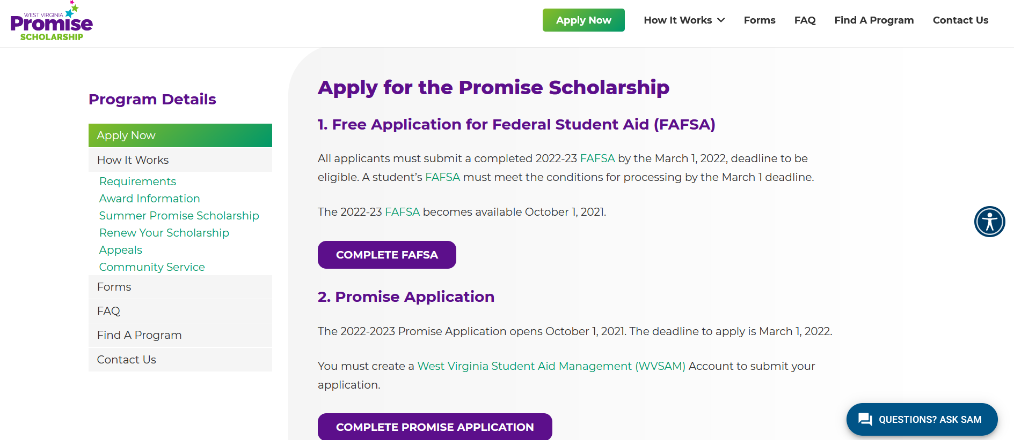
www.collegeforwv.com/promise

Slide 8
Check the status of your PROMISE Scholarship application on the WVSAM system
Award notices will be sent electronically to students via e-mail and text
Final eligibility is based upon 8th semester grades for students at both public and private high schools.

Slide 9
Check the status of your PROMISE Scholarship application on the WVSAM system
Award notices will be sent electronically to students via e-mail and text
Final eligibility is based upon 8th semester grades for students at both public and private high schools.

Slide 10
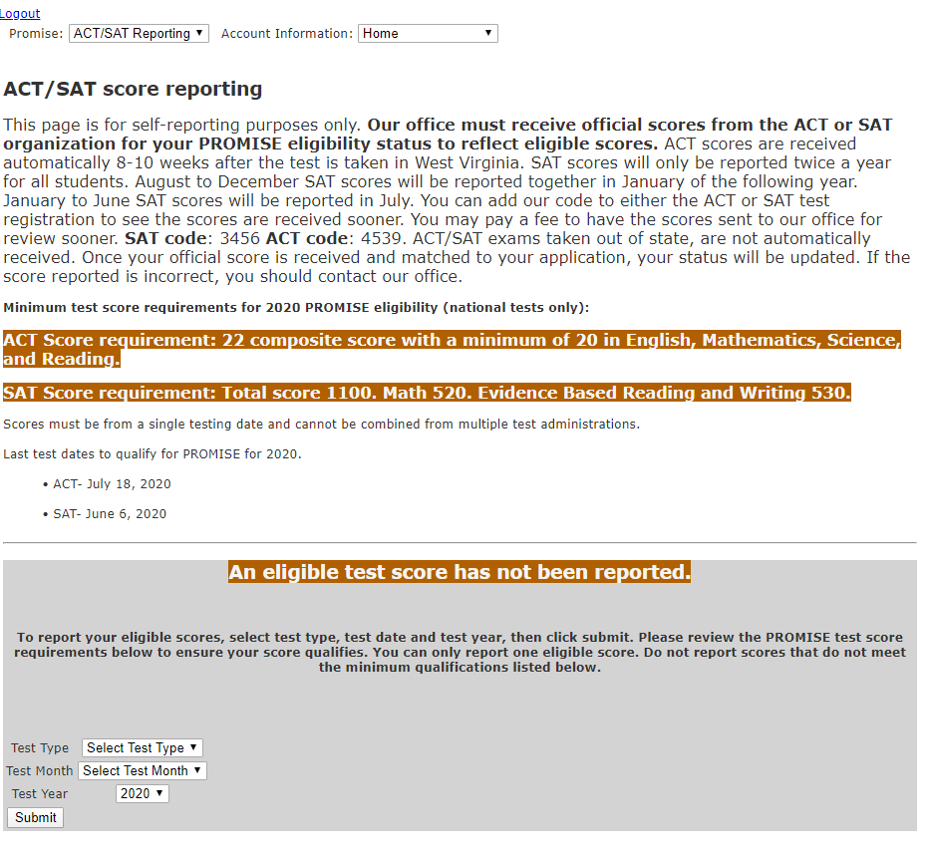
Not Official – Must receive official scores from ACT/SAT
Notes:
Students may not be eligible if they miss the deadline because of possible budget cuts

Slide 11
Merit-based scholarship/forgivable loan
1-year service requirement for each year the scholarship received
Online application at www.collegeforwv.com/wvstem/wvstem becomes available October 1.
March 1 application deadline
3.0 overall GPA
Enrolled or accepted for enrollment full-time in an engineering, science or technology program (4-yr, 2-yr or certificate). Approved programs determined by federal government.
Maximum annual award amount is $3,000
Requires student to complete promissory note

Slide 12
Merit-based scholarship/forgivable loan
December 31st for 1st round application deadline
Application available July 15, 2021
Must be enrolled as a full-time student in a course leading to certification as a teacher in critical need fields of math, science, special education, or elementary education.
Must have a 3.25 GPA and college ready test scores
Maximum annual award amount is $10,000
Renewed automatically up to 4 years
Service Requirement: Teach in critical need field for 5 years in WV

Slide 13
Scholarships for students going into nursing
Must have completed ½ of their program
Commit to work/teach in WV
For LPN, RN, LPN Teaching Certificate, MSN & Doctoral programs
www.wvcenterfornursing.org or www.cfwv.com
Application is available April 15-June 1 to apply for Fall 2022-Summer 2023

Slide 14
Institutional Aid
Academic Scholarships
Performance Scholarships
Entitlement Scholarships
Merit and Need-based Scholarships
Need-based Grants and Loans
Notes:
In addition to state and federal funds, the school you’re planning to attend might also have their own money they can award you. Check with each institution you’re considering for criteria, application and award guidelines. Here are some of the most common forms of institutional aid:
Academic scholarships are usually based on GPA and/or SAT or ACT test scores. Amounts and awarding criteria vary from school to school.
Performance scholarships usually include athletic, music, art, or drama scholarships. They may also include scholarships for being on the debate team, serving in student government, or on the school newspaper or yearbook staff.
Entitlement scholarships are offered by some schools for students who are the children of pastors, missionaries or Christian workers. Some schools may also offer discounts for the children of alumni or when more than one family member attends an institution.
Need-based grants and loans. Many schools offer grants and low interest (or interest free) loans to students based on financial need, or on a combination of need and academic merit. Some schools may require an additional institutional aid application (like PROFILE) for their need-based grants or loans.

Slide 15
Private Aid
Community Organizations
Churches
Employers and Labor Unions
Professional Associations
Corporations / Foundations
Private Loans
Notes:
Be sure to use any free scholarship searches to seek portable, private-sector scholarships. Most of these scholarships do not take income or assets into consideration.
Check with your high school or local Chamber of Commerce. They may have a list of local scholarship opportunities. Often your chances of being selected for local scholarships are much higher than they are for national scholarships.
Many companies, as well as labor unions, have programs to help pay the cost of postsecondary education for employees, members or their children.
Don’t overlook aid from organizations connected with your field of interest (for example, the American Medical Association or the National Society of Public Accountants). These organizations are listed in the U.S. Department of Labor’s Occupational Outlook Handbook and are also listed in various directories of associations available at your public library.
Many corporations and foundations offer scholarship opportunities as well - The Foundation of the Academy of Motion Picture Arts and Sciences, Business & Professional Women’s Foundation… the list goes on and on. Scholarship searches are particularly helpful in narrowing down scholarship opportunities from these sources. Remember, you’ll find links for up to five free scholarship searches at www.finaid.org, the Financial Aid Information Page.
There are private lending institutions which lend money to help meet the growing costs of a college education. Many of these private loans grant higher loan amounts, tax advantages, and repayment flexibility not found with regular student loan programs.

Slide 16
Academic Common Market
Selected programs not offered by colleges and universities in West Virginia
Students can receive in-state tuition at participating institutions
Go to www.sreb.org for more information
Notes:
There is an abundance of free financial aid information. Sources include state agencies, colleges and universities, lenders and other reputable organizations.
The Internet* offers you many informative websites on financial aid.
*NOTE: You will find a listing of important financial aid resources in the reference section of the Financial Aid Night Kit (R09). Using this form as a handout will give your audience a place to reference important phone numbers and websites that you mention to during this presentation.

Slide 17
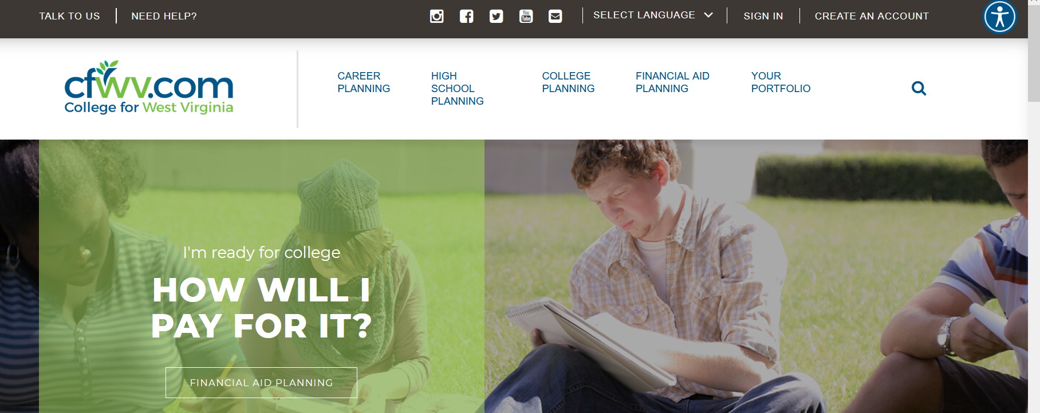
Follow CFWV!

Slide 19
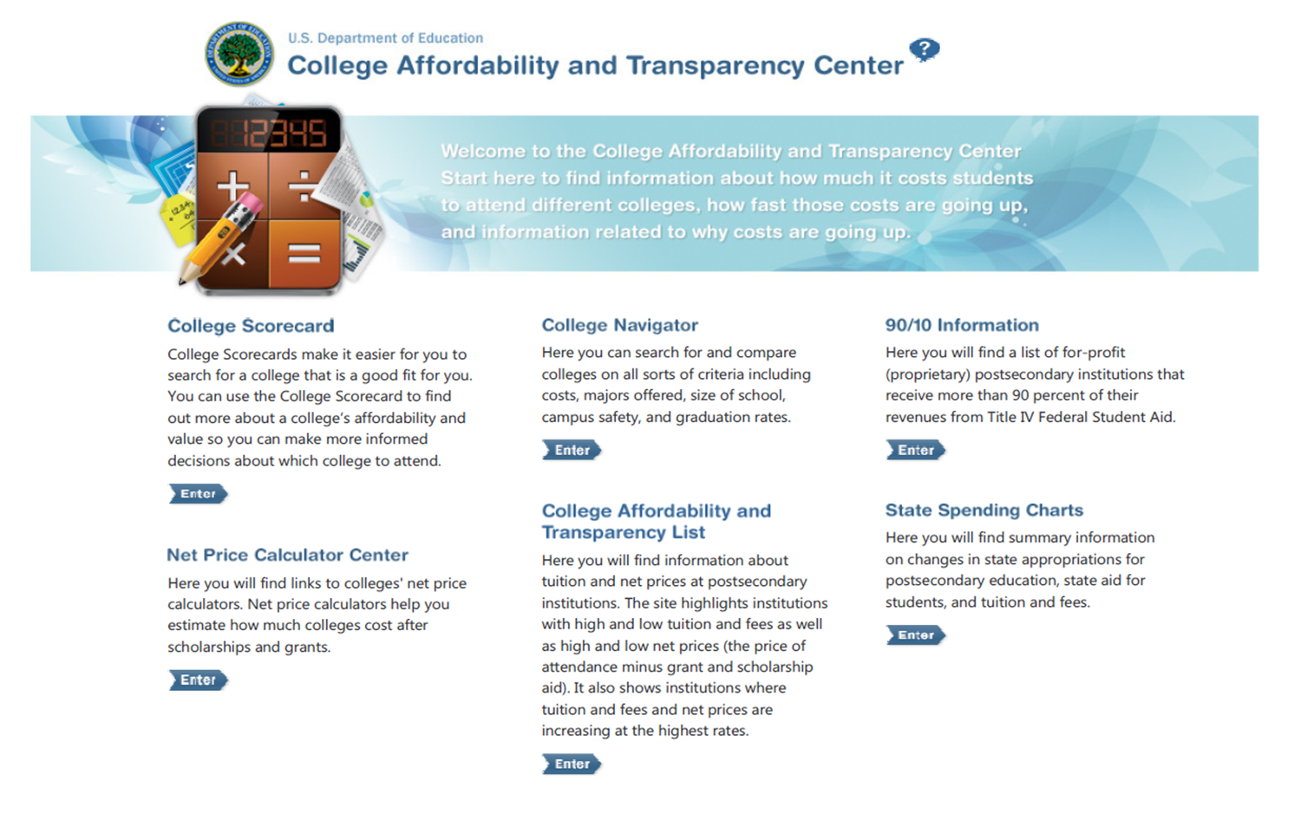
CollegeCost.ed.gov

Slide 20
Notes:
Please make sure when certifying GPAs of applicants that students are West Virginia residents.
There were phone calls from legislative staff of the education committee on the house of delegates side regarding students preparing to be STEM teachers receiving the ESTS scholarship. No legislation resulted.

Slide 21
Customer Service
Call for help!
Federal Financial Aid:
1-800-433-3243
State Financial Aid:
1-877-987-7664

Slide 22
Hi, my name is SAM. I am an artificially intelligent chatbot here to help answer student financial aid questions. How can I help?
Type live chat to speak directly with our staff during office hours.

Slide 23
Division of Financial Aid
West Virginia Higher Education Policy Commission
1018 Kanawha Boulevard East, Suite 700, Charleston, WV 25301
(304) 558-4618• wvfinancialaid@wvhepc.edu
www.wvhepc.edu

Slide 24
Questions
Notes:
Please make sure when certifying GPAs of applicants that students are West Virginia residents.
There were phone calls from legislative staff of the education committee on the house of delegates side regarding students preparing to be STEM teachers receiving the ESTS scholarship. No legislation resulted.

